Slide 1
NE 591: Advanced Reactor Materials
Fall 2021
Dr. Benjamin Beeler

Slide 2
Last Time

Slide 3
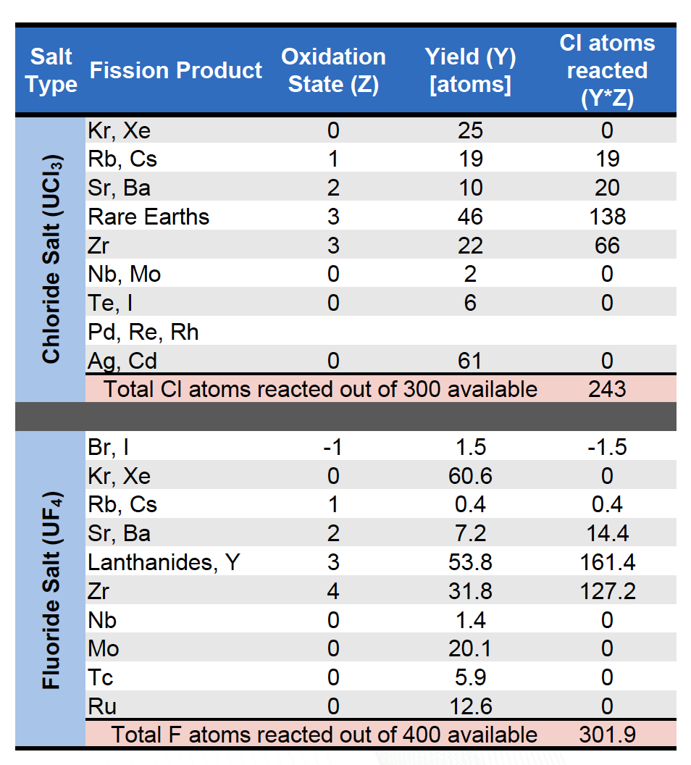
Changes During Fission
The fission process continuously alters the fuel salt redox conditions
When a U or Pu ion fissions, the available electrons will rearrange on each fission product to satisfy its valence requirements and produce either net oxidizing or reducing conditions in the melt
For UF4, four F ions are released; often fission products require less than four and thus there will be an excess of F ions with net oxidizing conditions

Slide 4
Fission Products
Distribution of fission products is a central safety issue
Fission products may be gaseous, solid, or dissolved
Alkaline and alkaline earth fission products form stable salts – Rb, Cs, Sr, Ba
Lanthanides and some transition metals can form stable salts
Semi-noble fission products plate out on metal surfaces – Nb, Mo, Tc, etc.
A few elements are very sensitive to redox changes
May elect to actively remove gaseous fission products
Lowers the in-core accident source term
Requires cooling fission product traps
Bubble formation and collapse results in reactivity jumps

Slide 5
Fission Product Plating
Noble metals are insoluble in the fluoride salt and can be found in helium sparge gas, on the graphite, or deposited on the metallic surfaces of the primary circuit
The deposited material contributes to the heat generation from its decay even after the reactor shutdown, decreasing the overall safety of the MSR
The deposits on the graphite specimens in the case of thermal reactors absorb neutrons during the operation and lead to lower efficiency of the reactor
One way of avoiding this detrimental precipitation is to remove the insoluble fission products by helium bubbling before they interact with the structural materials

Slide 6
Cover Gas
The cover gas (off-gas) handling system is a key element of any MSR
Fission gases such as xenon and krypton will readily escape the salt
Acidic gases may accumulate as a result of radiolysis
Tritium is formed by neutron interactions with light elements in the salt
The cover gas system will contain the radionuclides emerging from the free surface above the fuel salt as well as any sweep or sparging gases used

Slide 7
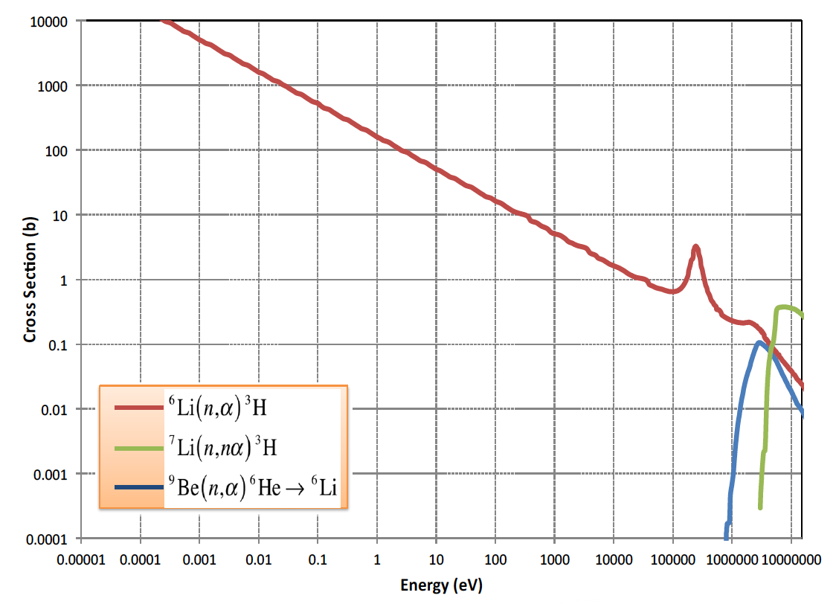
Tritium
Tritium production and control is an issue for Li-bearing salts
Tritium is produced by neutron reactions with lithium, beryllium, and fluorine as well as being a ternary fission product
Tritium can exist as ions of as TF, depending on redox conditions
Above 300C tritium will diffuse through structural materials

Slide 8
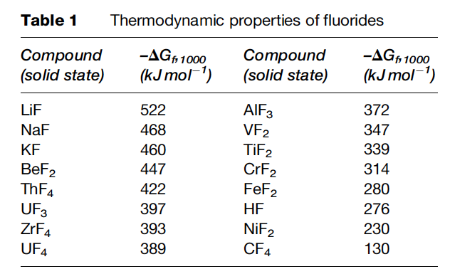
Radiolytic Stability
Molten salts are highly radiolytically stable
Radiolysis is the dissociation of molecules by ionizing radiation
Salts are combinations of strongly electronegative elements with strongly electropositive metals with very high bond energies
Formation energy of salts is more negative than metal fluorides
MSRE graphite and Hastelloy N exposed to coolant salt was untouched after ~3 years of operation

Slide 9
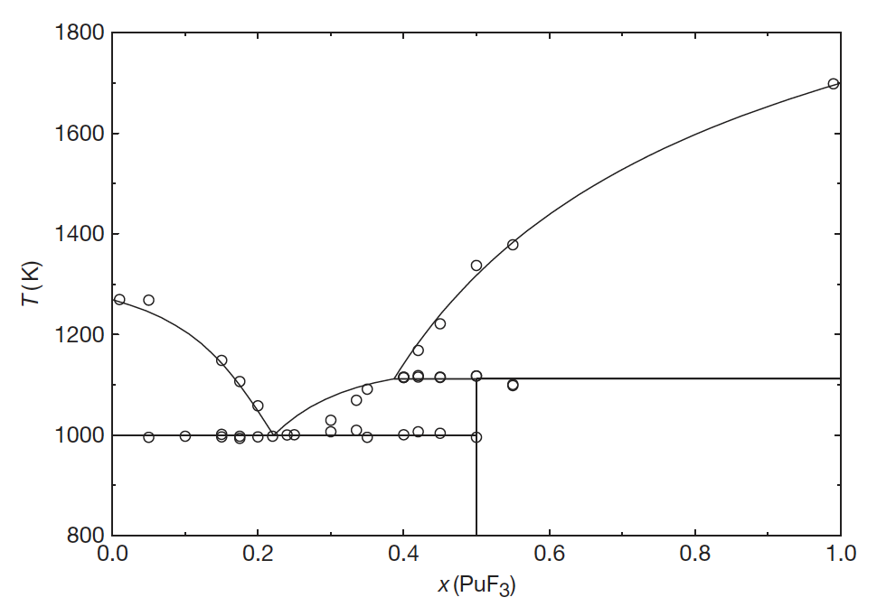
Na(ha)-Pu(ha)3

Slide 10
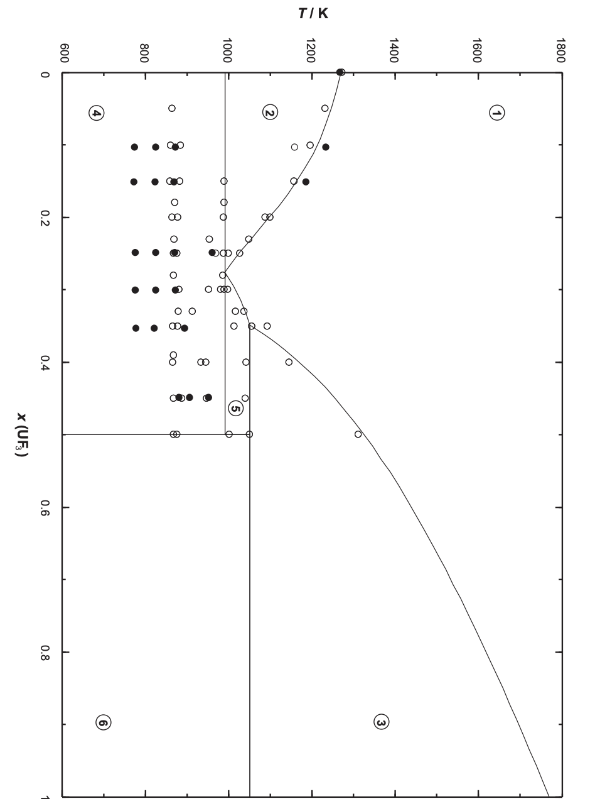
Na(ha)-U(ha)3

Slide 11
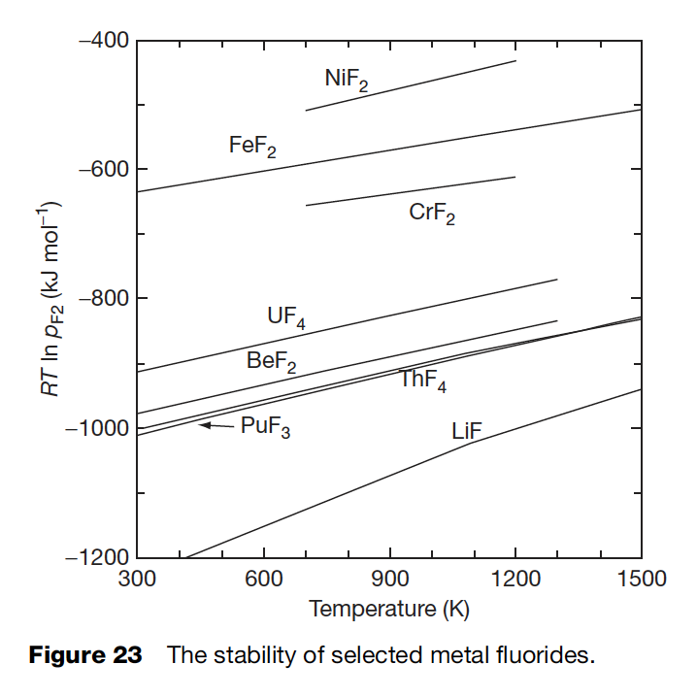
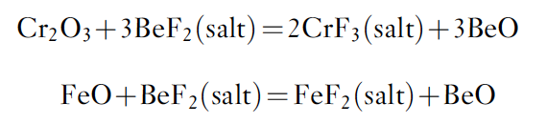
Corrosion of Structural Materials
Corrosion of the structural materials of the reactor by the molten salt may affect the chemistry and redox conditions of the fuel
The corrosion process to be considered in this context is the oxidation of metals in the alloy phase and their dissolution in the salt phase
Cr is the least stable element in relevant Ni-based alloys

Slide 12
Three principal corrosion processes
Reactions due to oxides on the metal
Reactions with dissolved impurities
Reactions with necessary constituents of the melt

Slide 13
Protective coatings?
It is not useful to apply a protective coating of, for example, an oxide layer on the structural material for the two following reasons:
although some oxides are relatively insoluble in the fluoride melt, most are readily dissolved
all oxides rapidly recrystallize
Oxide films on the surface of the alloy can be attacked by the fluoride melt
The formed oxides (BeO below) typically don’t matter as long as they do not contain fissile elements
The formed fluorides are more important as they will act as oxidants of Cr in the alloy

Slide 14
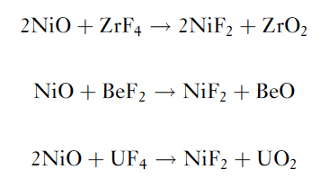
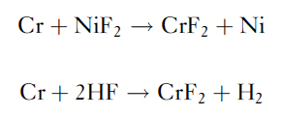
Oxide Films
Oxide films on the metal are dissolved, leading to cladding constituents
Other corrosion reactions are possible with solvent components
Such reactions can lead to rapid initial corrosion
These impurity reactions can be minimized by maintaining low impurity concentrations in the salt and on the alloy surfaces

Slide 15
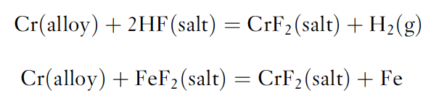
Dissolved Impurities
In addition to impurities generated by reactions with oxides, impurities may result from incomplete removal of HF or of easily reducible fluorides during the salt purification
This is done by successive reactions with HF–H2 and H2

Slide 16
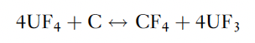
Graphite Compatibility
Graphite does not react with molten fluoride mixtures of the type to be used in the MSR concepts
After carbon, borides and nitrides appear to be the most compatible nonmetallic materials
Thermodynamic data suggest that the most likely reaction is:
but this should come to equilibrium at very low CF4 pressures
CF4 concentrations over graphite–salt systems maintained for long periods at elevated temperatures have been shown to be below the limit of detection

Slide 17
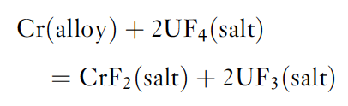
Constituents of the Melt
The oxidation reaction of alloy components with UF4 has been suggested to play an important role in corrosion
The below equation will define/buffer the electrochemical potential of the salt via the UF4/UF3 ratio
Based on reasonable estimations of the activity coefficients for the above reaction, the equilibrium concentration of CrF2 is of the order of 130–300 ppm for a fuel with 1% UF3 contained in Hastelloy-N

Slide 18
Tellerium
When Te is present in the metallic form in the fuel, it corrodes Ni-based alloys and embrittles its surface grain boundaries
Embrittlement is a vital issue to consider because it can result in cracking of the structural materials
This intergranular embrittlement produced in Hastelloy-N can be significantly reduced by adding 1–2 wt% of niobium into the Hastelloy-N
Another way to suppress the corrosion rate is by increasing the reducing conditions of the fuel, which is done by the increasing the UF3/UF4 ratio
This allows Te to be present as Te⁻² rather than in an ‘oxidized’ metallic form, and this is less aggressive against the nickel-based alloys

Slide 19
Materials for MSR systems
The materials required fall into three main categories: (1) metallic components for primary and secondary circuits, (2) graphite in the core, and (3) materials for molten-salt fuel reprocessing systems
The metallic material used in constructing the primary circuit of an MSR will operate at temperatures up to 700–750C

Slide 20
Isotope Separation
This is a significant issue for both fluoride and chloride salts
⁶Li has a large thermal neutron cross section
Absorption in ³⁵Cl both produces radioactive ³⁶Cl and results in a reactivity penalty
COLEX process utilizes mercury for Li separations

Slide 21
Summary
MSRs can be designed as a thermal (graphite-moderated), a nonmoderated breeder reactor, or as an actinide burner to manage the plutonium and the long-lived minor actinides
The thermodynamic description of the fuel systems is available and, based on these results, the liquidus temperatures, vapor pressures, and the solubility of actinide fluorides in the fuel solvent can be adequately derived, however, the addition of other matrix components must be investigated
There are strong data needs for viscosity, heat capacity, thermal conductivity, etc. for fresh salts, and essentially no data exists for irradiated salts
There is generally more data on fluoride salts than on chlorides
Corrosion of fuel salt on structural materials is very important, but can be mitigated through control of the REDOX potential

